Slide 1


Kadir Baver Kerimoğlu
16th April 2022

Slide 2

Outline
Executive Summary
Introduction
Methodology
Results
Conclusion
Appendix

Slide 3
Executive Summary
Summary of methodologies
- Data Collection with API
- Data Collection with Web Scraping
- Data Wrangling
- Exploratory Data Analysis with SQL
- Exploratory Data Analysis with Data Visualization
- Interactive Visual Analytics with Folium
- Machine Learning Prediction
Summary of all results
- Exploratory Data Analysis result
- Interactive Analytics in Dash Plotly
- Predictive Analysis result

Slide 4
Introduction
Project background and context
Space X advertises Falcon 9 rocket launches on its website with a cost of 62 million dollars; other providers cost upward of 165 million dollars each, much of the savings is because Space X can reuse the first stage. Therefore, if we can determine if the first stage will land, we can determine the cost of a launch. This information can be used if an alternate company wants to bid against space X for a rocket launch. This goal of the project is to create a machine learning pipeline to predict if the first stage will land successfully.
Problems you want to find answers
What factors determine if the rocket will land successfully?
The interaction amongst various features that determine the success rate of a successful landing.
What operating conditions needs to be in place to ensure a successful landing program?

Slide 5

Section 1

Slide 6
Methodology
Executive Summary
Data collection methodology:
Data was collected using SpaceX Rest API and Web Scraping from Wikipedia.
Perform data wrangling
One hot encoding was applied to categorical columns for machine learning prediction and dropping irrelevant columns.
Perform exploratory data analysis (EDA) using visualization and SQL
Perform interactive visual analytics using Folium and Plotly Dash
Perform predictive analysis using classification models
Build, tune, evaluate classification models

Slide 7
Data Collection
Data sets was collected as follows;
- Performed data collection by using get request the SpaceX Rest API.
- Next step, we decoded the response content as a Json by calling .json() function and turn it into a pandas dataframe by using .json_normalize().
- We then cleaned the data, checked for missing values and fill in missing values where necessary.
- Moreover, we performed web scraping from Wikipedia for Falcon 9 launch records with BeautifulSoup.
- The objective was to extract the launch records as HTML table, parse the table and convert it to a pandas dataframe for future analysis.

Slide 8
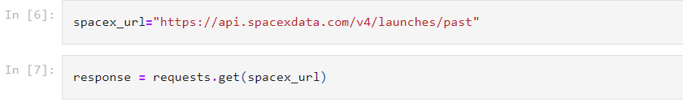
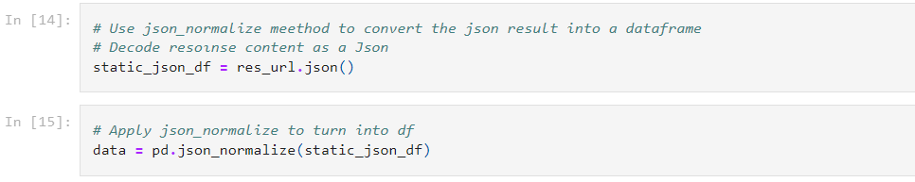
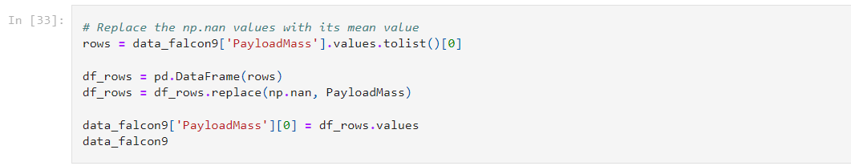
Data Collection – SpaceX API
We used the get request to the SpaceX API to collect data, clean the requested data and did some basic data wrangling and formatting.
GitHub URL is as follow; https://github.com/kbkerimoglu/kbkerimoglu.github.io/blob/master/IBM_Data_Science_Capstone_Project_SpaceX/Data%20Collection%20with%20API.ipynb
1. Get request for rocket launches data from SpaceX API with the following URL.
2. Decoded the response content as a Json using .json() and turn it into a Pandas dataframe using .json_normalize().
3. Then performed data cleaning and filling the missing values with mean.

Slide 9
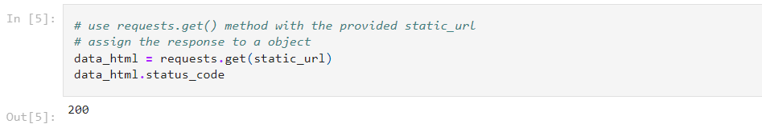
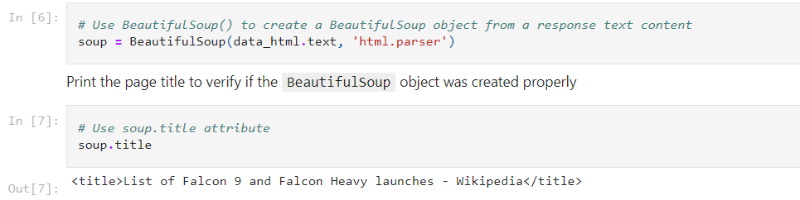
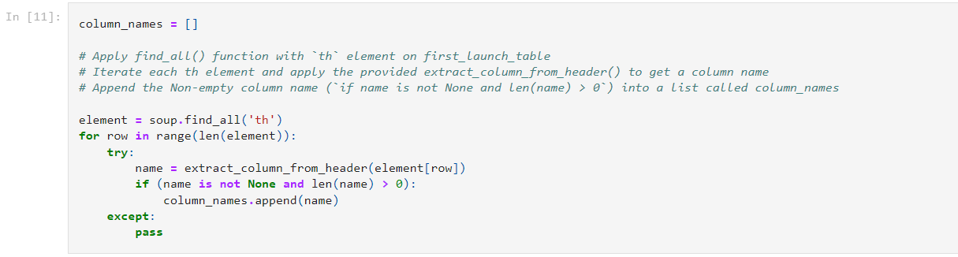
Data Collection - Scraping
We applied web scrapping to webscrap Falcon 9 launch records with BeautifulSoup
We parsed the table and converted it into a pandas dataframe.
https://github.com/kbkerimoglu/kbkerimoglu.github.io/blob/master/IBM_Data_Science_Capstone_Project_SpaceX/Data%20Collection%20with%20Web%20Scraping.ipynb
1. Scraped data from snapshot of the Falcon 9 rocket launch page from Wikipedia.
2. Performed an HTTP GET method to request the Falcon 9 launch HTML page.
3. Create BeatifulSoup object from the HTML response.
4. Extracted all column names one by one from HTML table reader.
5. Created a dataframe by parsing the launch HTML tables.
6. Exported data to csv.

Slide 10

Data Wrangling
We performed exploratory data analysis and determined the training labels.
We calculated the number of launches at each site, and the number and occurrence of each orbits
We created landing outcome label from outcome column and exported the results to csv.
The link to the GitHub URL is; https://github.com/kbkerimoglu/kbkerimoglu.github.io/blob/master/IBM_Data_Science_Capstone_Project_SpaceX/Data%20Wrangling.ipynb

Slide 11
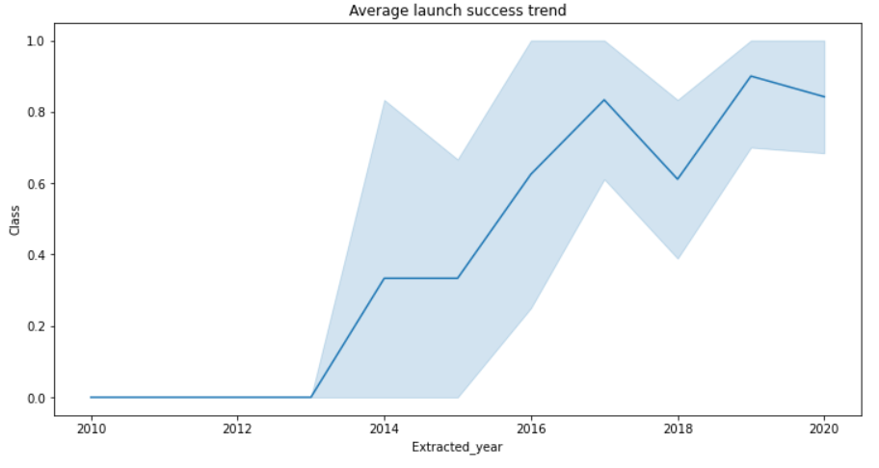

EDA with Data Visualization
Analyze the ploted bar chart try to find which orbits have high sucess rate.
We can see from bar chart, while ESL-1, GEO, HEO and SSO orbits that have highest success rate with 100%, SO orbit has the least success rate with 0%.
Plotted line chart to get yearly average launch success trend. We can observe that the sucess rate since 2013 kept increasing till 2020.
The link to the GitHub URL is; https://github.com/kbkerimoglu/kbkerimoglu.github.io/blob/master/IBM_Data_Science_Capstone_Project_SpaceX/EDA%20with%20Visualization.ipynb

Slide 12
EDA with SQL
We loaded the SpaceX dataset into a PostgreSQL database without leaving the Jupyter Notebook.
We applied EDA with SQL to get insight from the data. We wrote queries to find out for instance:
The names of unique launch sites in the space mission.
The total payload mass carried by boosters launched by NASA (CRS)
The date where the first succesful landing outcome in drone ship was acheived.
The names of the booster versions which have carried the maximum payload mass.
The failed landing outcomes in drone ship, their booster version and launch site names.
The link to the GitHub URL is; https://github.com/kbkerimoglu/kbkerimoglu.github.io/blob/master/IBM_Data_Science_Capstone_Project_SpaceX/EDA%20with%20SQL.ipynb

Slide 13
Build an Interactive Map with Folium
We marked all launch sites, and added map objects such as markers, circles, lines to mark the success or failure of launches for each site on the folium map.
We assigned the feature launch outcomes (failure or success) to class 0 and 1.i.e., 0 for failure, and 1 for success.
Using the color-labeled marker clusters, we identified which launch sites have relatively high success rate.
We calculated the distances between a launch site to its proximities. We answered some question for instance:
Are launch sites near railways, highways and coastlines.
Do launch sites keep certain distance away from cities.
The link to the GitHub URL is; https://github.com/kbkerimoglu/kbkerimoglu.github.io/blob/master/IBM_Data_Science_Capstone_Project_SpaceX/Interactive%20Visual%20Analytics%20with%20Folium.ipynb

Slide 14
Build a Dashboard with Plotly Dash
We built an interactive dashboard with Plotly dash
We plotted pie charts showing the total launches by a certain sites
We plotted scatter graph showing the relationship with Outcome and Payload Mass (Kg) for the different booster version.
The link to the GitHub URL is; https://github.com/kbkerimoglu/kbkerimoglu.github.io/blob/master/IBM_Data_Science_Capstone_Project_SpaceX/spacex_dash_app.py

Slide 15
Predictive Analysis (Classification)
We loaded the data using numpy and pandas, transformed the data, split our data into training and testing.
We built different machine learning models and tune different hyperparameters using GridSearchCV.
We used accuracy as the metric for our model, improved the model using feature engineering and algorithm tuning.
We found the best performing classification model.
The link to the Github URL is; https://github.com/kbkerimoglu/kbkerimoglu.github.io/blob/master/IBM_Data_Science_Capstone_Project_SpaceX/Machine%20Learning%20Prediction.ipynb

Slide 16
Results
Exploratory data analysis results
Interactive analytics demo in screenshots
Predictive analysis results

Slide 17

Section 2

Slide 18

Flight Number vs. Launch Site
As we can see on the line chart, the success rate increases as the flight number increases.

Slide 19
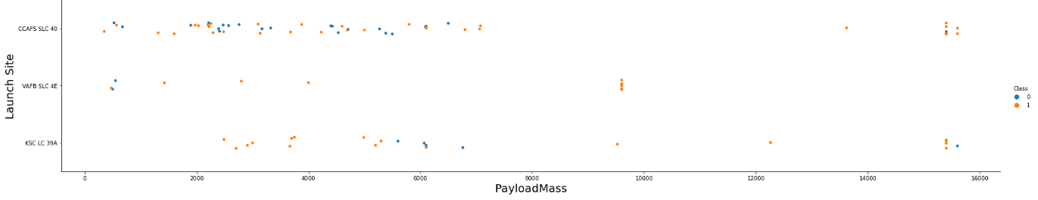
Payload vs. Launch Site
We can observe Payload Vs. Launch Site scatter point chart that for the VAFB-SLC launchsite there are no rockets launched for heavypayload mass(greater than 10000).

Slide 20

Success Rate vs. Orbit Type
We can see from bar chart, while ESL-1, GEO, HEO and SSO orbits that have highest success rate with 100%, SO orbit has the least success rate with 0%.

Slide 21
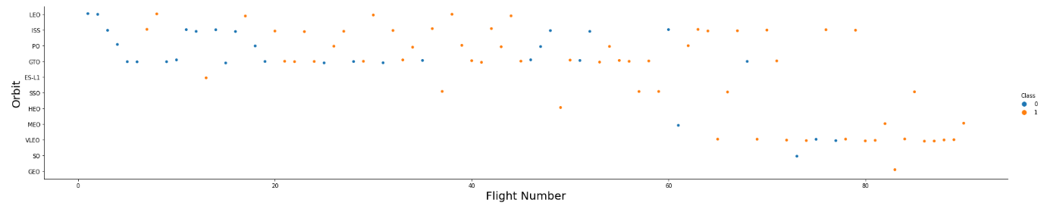
Flight Number vs. Orbit Type
The line chart below illustrates that in the LEO orbit the Success appears related to the number of flights; on the other hand, there seems to be no relationship between flight number when in GTO orbit.

Slide 22
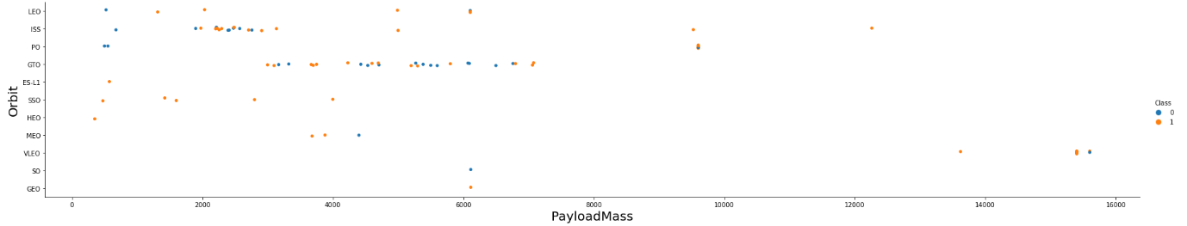
Payload vs. Orbit Type
With heavy payloads the successful landing or positive landing rate are more for Polar,LEO and ISS. However for GTO we cannot distinguish this well as both positive landing rate and negative landing(unsuccessful mission) are both there here.

Slide 23

Launch Success Yearly Trend
The line chart illustrates that the sucess rate since 2013 kept increasing till 2020.

Slide 24
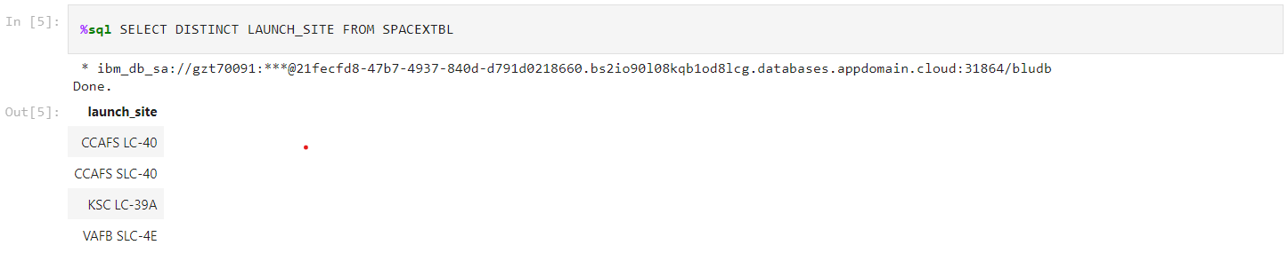
All Launch Site Names
We used the key word DISTINCT to show only unique launch sites from the SpaceX table.

Slide 25
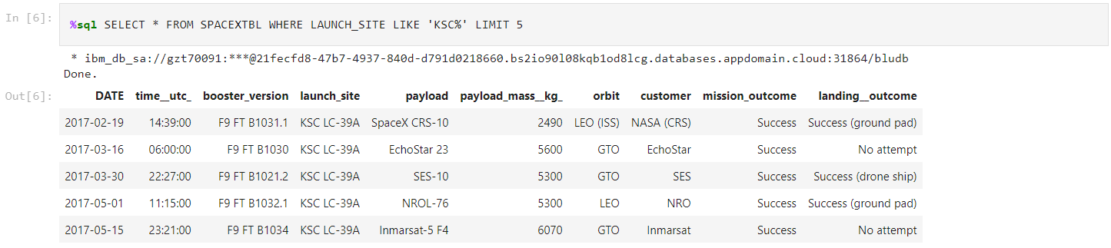
Launch Site Names Begin with 'KSC'
We used the query above to display 5 records where launch sites begin with `KSC`.

Slide 26
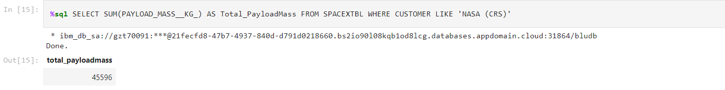
Total Payload Mass
We calculated the total payload carried by boosters from NASA as 45596 using the query below

Slide 27
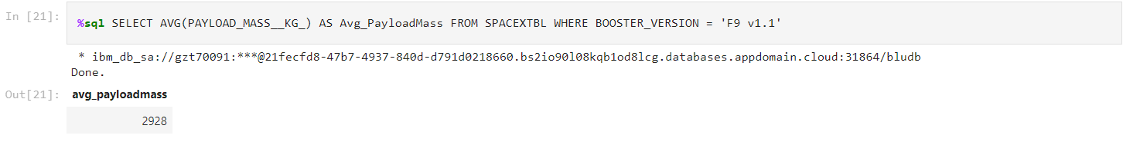
Average Payload Mass by F9 v1.1
We calculated the average payload mass carried by booster version F9 v1.1 as 2928.

Slide 28
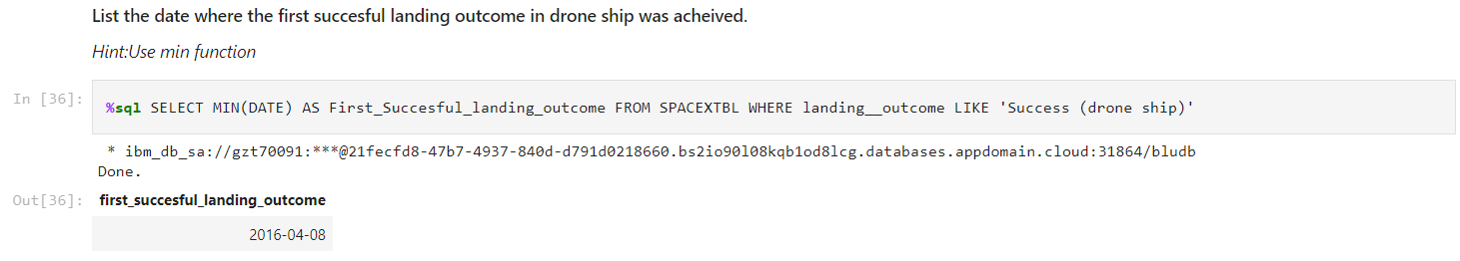
First Successful Drone Ship Landing Date
We observed that the dates of the first successful landing outcome on drone ship was 8th April 2016.

Slide 29
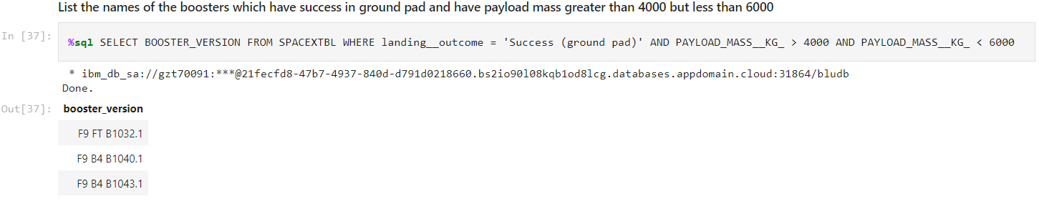
Successful Drone Ship Landing with Payload between 4000 and 6000
We used the WHERE clause to filter for boosters which have successfully landed on ground pad and applied the AND condition to determine successful landing with payload mass greater than 4000 but less than 6000.

Slide 30
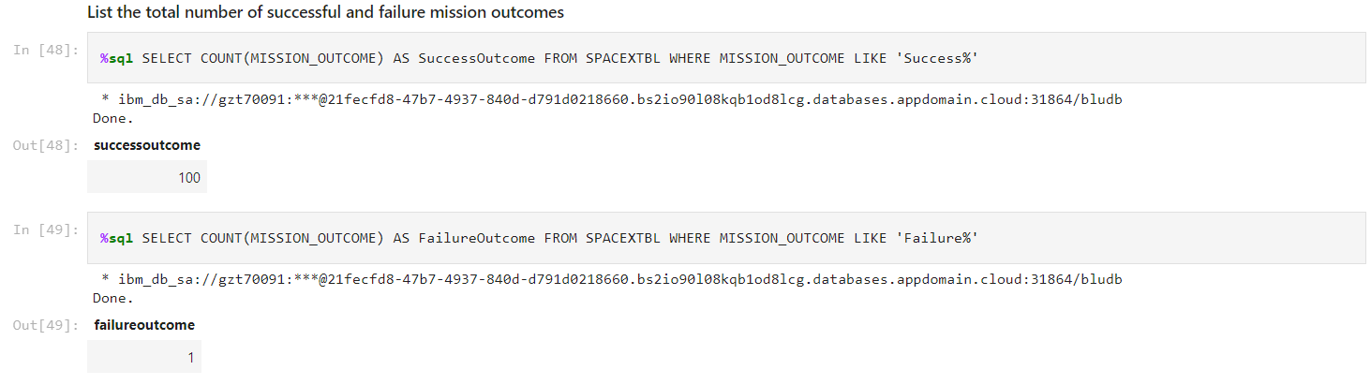
Total Number of Successful and Failure Mission Outcomes
We used like ‘%’ function to filter for WHERE Mission_Outcome was a success or a failure. We can see from results, total number of successful and failure missions are 101.

Slide 31
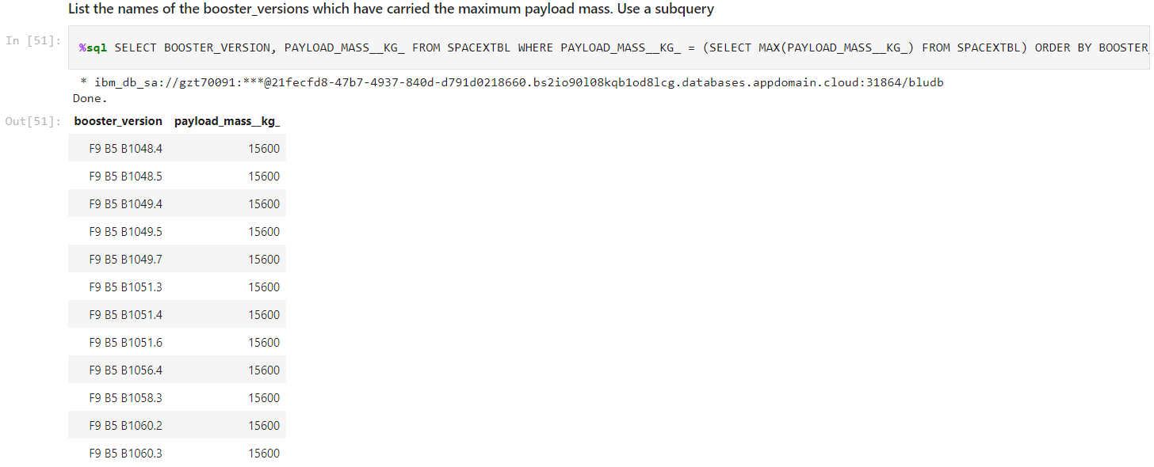
Boosters Carried Maximum Payload
We determined the booster that have carried the maximum payload using a subquery in the WHERE clause and the MAX() function.

Slide 32
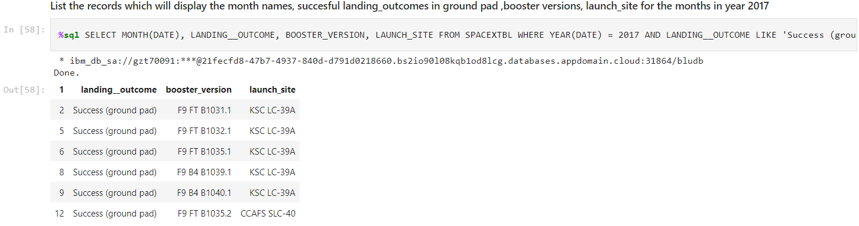
2017 Launch Records
We used a combinations of the WHERE clause, LIKE and AND conditions to filter for successful landing outcomes in ground pad, their booster versions, and launch site names for year 2017.

Slide 33
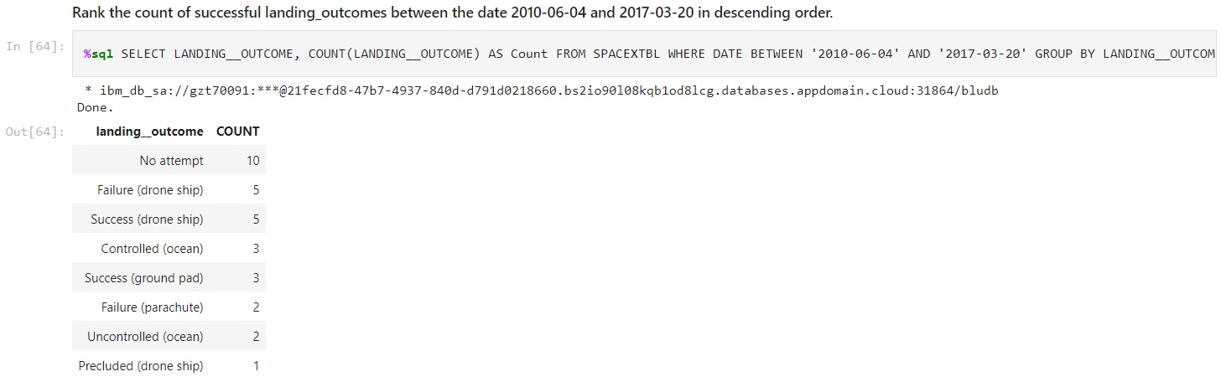
Rank Landing Outcomes Between 2010-06-04 and 2017-03-20
We selected landing outcomes and the COUNT of landing outcomes from the data and used the WHERE clause to filter for landing outcomes BETWEEN 2010-06-04 to 2017-03-20.
We applied the GROUP BY clause to group the landing outcomes and the ORDER BY clause to order the grouped landing outcome in descending order.

Slide 34

Section 3

Slide 35
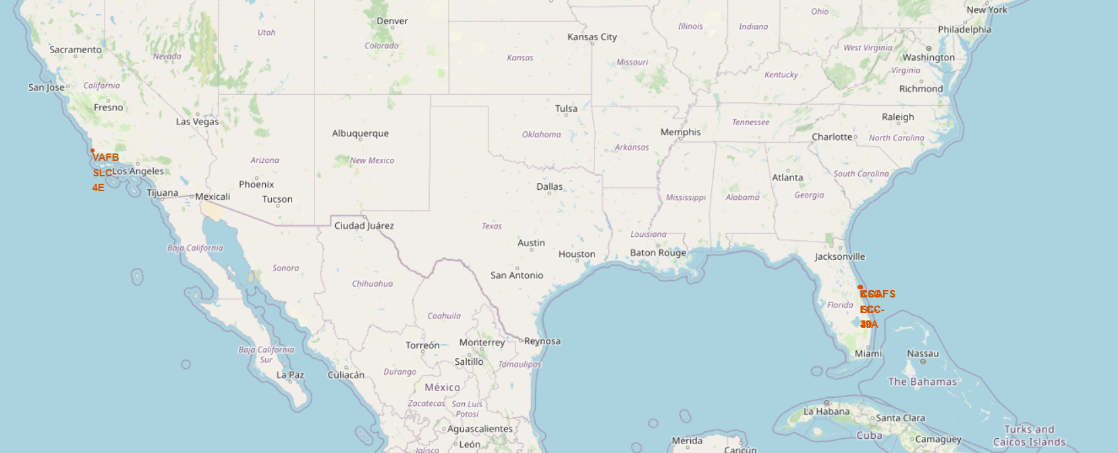
Mark All Launches Sites on a Global Map
As we can see on the map, the SpaceX launch sites are located on the coasts of the states of California and Florida.

Slide 36

Mark the Success/Failed Launches for Each Site on the Map

Slide 37

The Distances Between Launch Sites to Its Proximities

Slide 38

Section 4

Slide 39
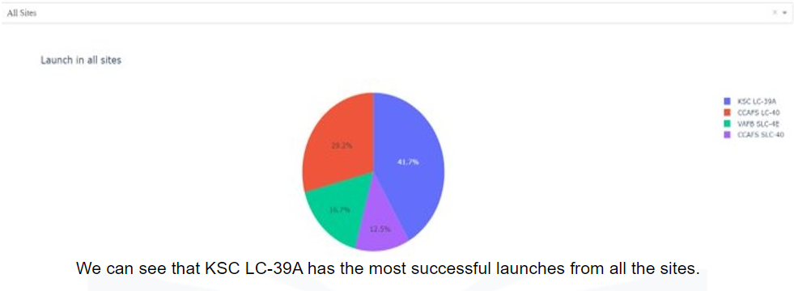
All Launch Sites Success Rate with Pie Chart

Slide 40
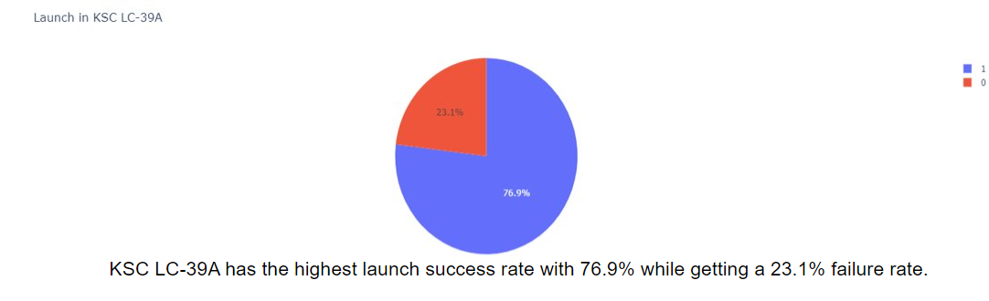
Highest Launch Site Success Ratio with Pie Chart

Slide 41
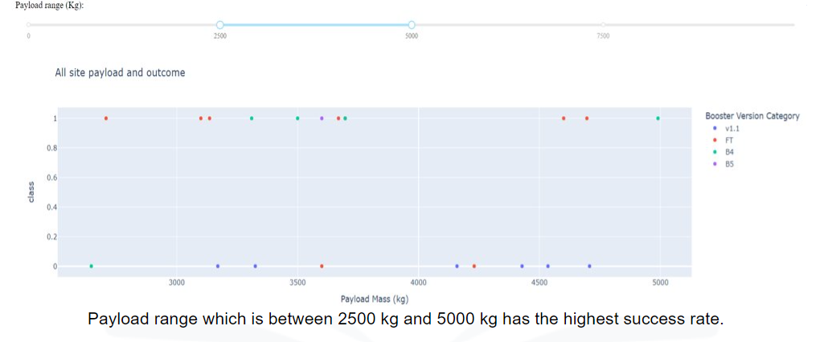
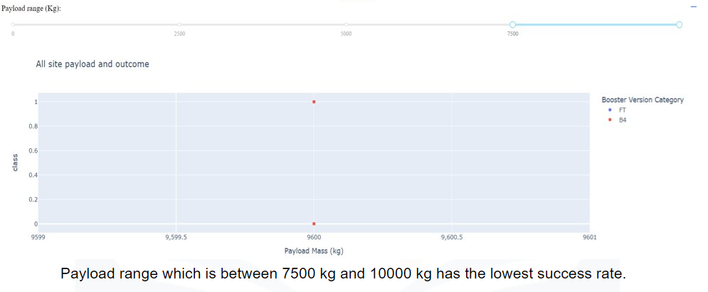
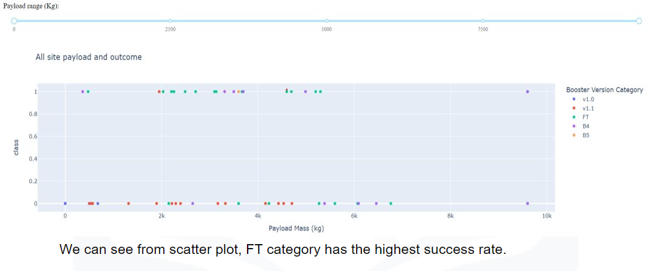
Scatter Plot of Payload vs Launch Outcome for all Category, with Different Payload Range

Slide 42

Section 5

Slide 43
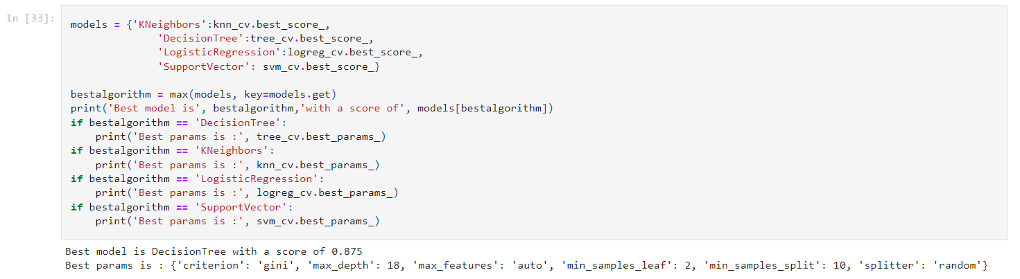
Classification Accuracy
The best model with the highest classification accuracy (87.5%) is the decision tree classifier.

Slide 44
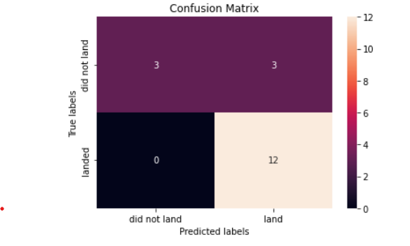
Confusion Matrix
The Confusion Matrix for decision tree classifier illustrates that the classifier can distinguish between the different classes. We see that the major problem is false positives.

Slide 45
Conclusions
We can conclude that:
The success rate increases as the flight number increases.
While ESL-1, GEO, HEO and SSO orbits that have highest success rate with 100%, SO orbit has the least success rate with 0%.
The sucess rate since 2013 kept increasing till 2020.
The total payload carried by boosters from NASA as 45596.
The dates of the first successful landing outcome on drone ship was 8th April 2016.
The SpaceX launch sites are located on the coasts of the states of California and Florida.
KSC LC-39A had the most successful launches from all sites.
The best model with the highest classification accuracy (87.5%) is the decision tree classifier.

Slide 46


